Slide 1
Decline in Television viewership and the rise of streaming services.
NETFLIX

Slide 3
Overview
A decade ago, if you told me I would not have cable TV or a radio in my house I’d have laughed at you. Today, I stream television shows and movies via apps on my Fire Stick. I listen to music on Spotify and Apple Music.
This got me thinking: how did streaming become so popular? How did Netflix go from a DVD rental-by-mail company to the leading streaming service and award winning producer of content? How do the major streaming services match up when it comes to social and hiring data?
Their stories …

Slide 4
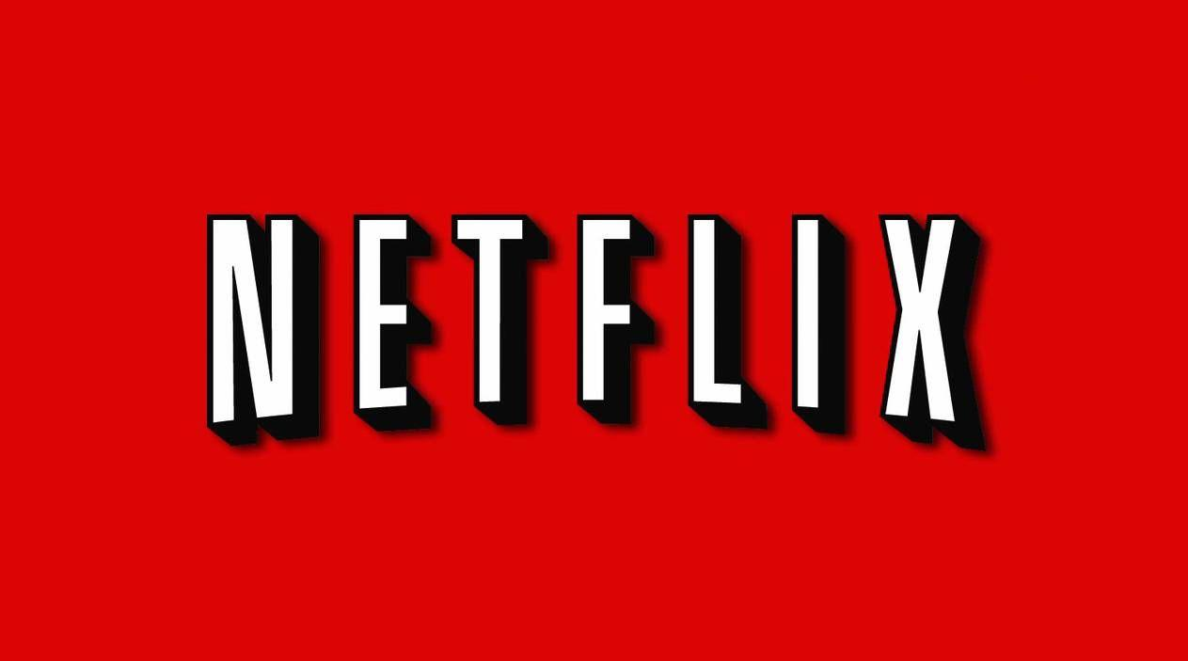

Slide 5
History
Netflix initially started as a DVD rental service in 1998. It mostly relied on a third party postal services to deliver its DVDs to the users. This resulted in heavy losses which they soon mitigated with the introduction of their online streaming service in 2007. In order to make this happen, Netflix invested in a lot of algorithms to provide a flawless movie experience to its users. One of such algorithms is the recommendation system that is used by Netflix to provide suggestions to the users. A recommendation system understands the needs of the users and provides suggestions of the various cinematographic products.
Netflix introduced streaming services in 2007. In 2013, “House of Cards,” the first Netflix-produced show premiered. Today some of the world's most beloved shows — including "Orange Is the New Black," "Bloodline," "Stranger Things, and "Master of None" — are Netflix productions.
Netflix now has more than 154 million subscribers. There is one Blockbuster store left in existence in Bend, Oregon.

Slide 6
How Netflix Solved its Recommendation Problem with Data Science
Back in 2006 when Netflix wanted to tap into the streaming market, it started off with a competition for movie rating prediction. It provided a prize of $ 1 million to whoever increased the accuracy of their then existing platform ‘Cinematch’ by 10%. At the end of competition, the BellKor team presented their solution that increased the accuracy of prediction by 10.06%. With over 200 work hours and an ensemble of 107 algorithms provided them with this result. Their final model gave an RMSE of 0.8712. For their solution, they made use of K-nearest neighbor algorithm for post-processing of the data.
However, even after reduction of RMSE and increase in accuracy, Netflix suffered from two major challenges – Firstly, the data that provided during the competition comprised of 100 million movie ratings, as opposed to more than 5 billion ratings that Netflix constituted of. Furthermore, the algorithms were static, meaning that they only dealt with historical data and did not take into account the dynamicity of users adding reviews in real-time. After Netflix overcame these challenges, it made the winning algorithms a part of its recommendation system.

Slide 7
Contents
Using Machine Learning to Improve Streaming Quality at Netflix
Netflix knows what you want to watch next
How Netflix Decides Artworks
How Netflix decides its Original Series

Slide 8
Using Machine Learning to Improve Streaming Quality at Netflix
One of the common questions we get asked is: “Why do we need machine learning to improve streaming quality?”
Netflix streams to over 117M members worldwide. Well over half of those members live outside the United States, where there is a great opportunity to grow and bring Netflix to more consumers. Providing a quality streaming experience for this global audience is an immense technical challenge. A large portion of this is engineering effort required to install and maintain servers throughout the world, as well as algorithms for streaming content from those servers to our subscribers’ devices.
Solution for streaming video becomes increasingly suboptimal. For example:

Slide 9
Viewing/browsing behavior on mobile devices is different than on Smart TVs
Cellular networks may be more volatile and unstable than fixed broadband networks
Networks in some markets may experience higher degrees of congestion
Different device groups have different capabilities and fidelities of internet connection due to hardware differences

Slide 10
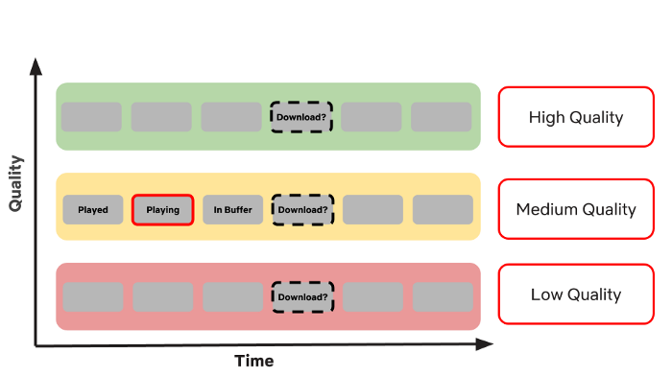
Illustration of the video quality adaptation problem. The video is encoded at different qualities (in this case 3 qualities: high in green, medium in yellow, low in red). Each quality version of the video is divided up into chunks of a fixed duration (grey boxes). A decision is made about which quality to choose for each chunk that is downloaded.

Slide 11
Netflix knows what you want to watch next
Netflix knows more about your viewing habits than you think. Now, this might sound scary, but it’s pure statistics. The prediction systems powered by algorithms know what we prefer to watch before we do.
Analyzing data and gaining insights have been the pillar behind the success of Netflix in recent years. They are able to gather insights, adjust algorithms, and optimize streaming experience.
Here’s a look at some of the “events” Netflix tracks:

Slide 12
When you pause, rewind, or fast forward
What day you watch content
(Netflix has found people watch TV shows during the week
and movies during the weekend.)
The date you watch
What time you watch content
Where you watch (zip code)
What device you use to watch
(Do you like to use your tablet for TV shows and your Roku for movies?
Do people access the Just for Kids feature more on their iPads, etc.?)
When you pause and leave content (and if you ever come back)
The ratings given (about 4 million per day)
Searches (about 3 million per day)
Browsing and scrolling behavior

Slide 13
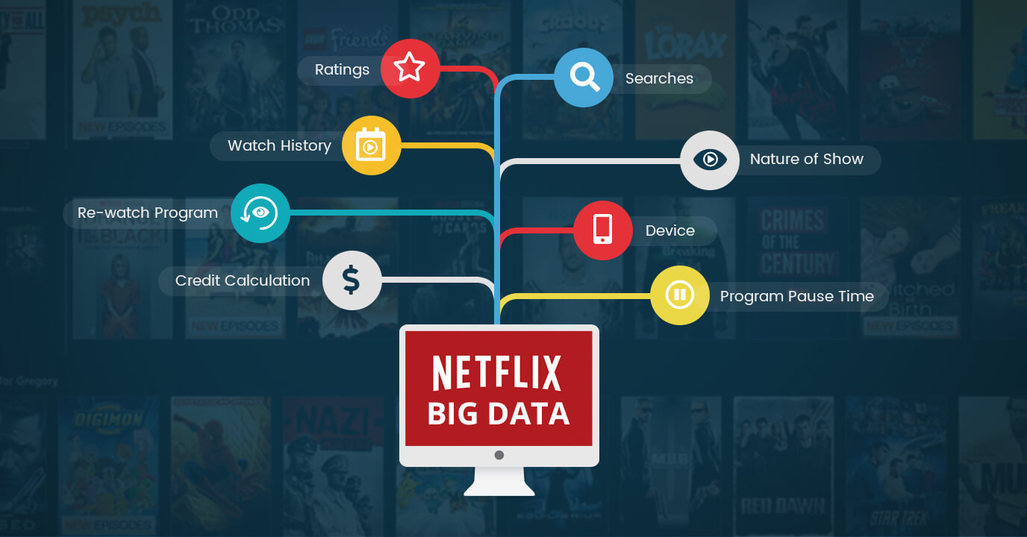

Slide 14
How Netflix Decides Artworks
Netflix sets themselves apart from traditional media companies not only by what they recommend but how they recommend it to their members. A key feature are the image they use to promote each movie or TV show - the so called artworks.
Netflix aims to provide the artwork for each show that highlights the specific visual clue that is relevant for each individual member.
For each new title different images are randomly assigned to different subscribers, using the taste communities as an initial guideline.

Slide 15
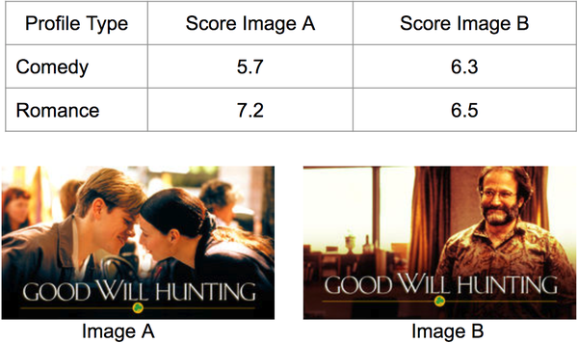
(The example above is a of contextual image selection based on the type of profile. The contextual bandit selects the image of Robin Williams, a famous comedian, for comedy-inclined profiles while selecting an image of a kissing couple for profiles more inclined towards romance)
This translates into hundred of millions of personalized images continously being tested among its subscriber base.

Slide 16
How Netflix decides its Original Series
In 2013 just before the 2013 United States Senate special election, Netflix released it first ever Original Series ‘House of Cards’ based on a political drama which was a hit and bought Netflix 2.1 million subscribers.
Since then it starting producing Original series at a fast pace.
Netflix also began expanding across the globe and started producing Originals with the local actors of various countries.
Netflix started using Data Analysis techniques to predict users choice of series.
Here is the data of every Netflix originals ever made and how Netflix uses Analysis techniques to decide which series should be continued, which should be terminated and which news series should be produced next.

Slide 19
Future Scope
Overtaking the local competition
Targeting the countries with lowest penetration
Netflix stepping into live streaming service-under the future segment

Slide 20
Overtaking the local competition
One of the main challenges of Netflix in future would be overtaking the future competition. For example the biggest competition for Netflix in India is Hotsar which has over 280 million active users.
As we no that each country has its own streaming services with a loyal subscriber base.
Using the following data Netflix can target the local competition by the following ways

Slide 24
When considering the percent Netflix costs versus the average median income of a country, Japan comes out on top. Netflix only costs 0.17 percent of the average person’s annual earnings in that country. (Source: Comparitech)
Meanwhile, Netflix is a costly purchase for the average Indian, as the price is nearly 5 percent of the average annual income in that country. (Source: Comparitech)

Slide 25
Targeting the countries with lowest penetration
Local content is the key driver
Entertainment shapes are often shaped by culture and geography.
Despite of fixing the cost, Netflix should also focus on producing local content in each of its contries with the least penetration.
This will enhance its subscriber base.

Slide 26
Country wise penetration

Slide 27
Country wise Area of Interest

Slide 29
Netflix stepping into live streaming service under the future segment a
Worldwide Sports industry stands at around 480Billion$ to 620billion$. This opens up the business for Sports streaming worldwide.
We have taken in consideration few of the countries and their fan following worldwide. This is one such big market that Netflix could dive into. Disney’s Indian video streaming partner Hotstar created a record of simultaneous users watching an OTT(Over the Top) event which was set at 18.6 million.
This is one such goldmine that could pool in huge subscription and bigger advertisement revenues.This would need Netflix to have strategic partners for particular sports worldwide coverage and the costing of which is gargantuan but the demand and supply cost ratio could be taken care by the advertisement sector.
The data table shows the top following sports and the revenue share for the same. We believe this could be the next strategic move for the DVD rental store to make it worldwide recognized brand next to Coca Cola and Pepsi .

Slide 30
Top 5 Sports streaming countries

Slide 31
Revenue VS Estimated Budget

Slide 33
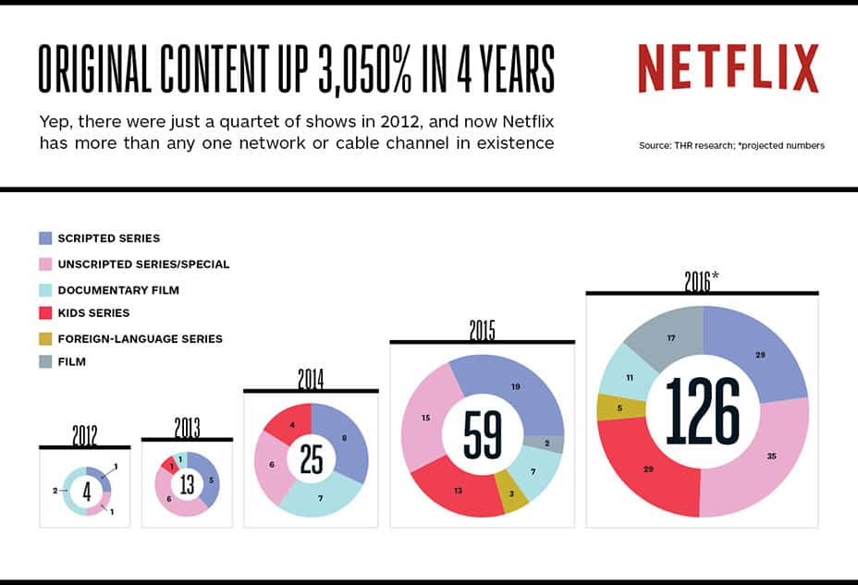
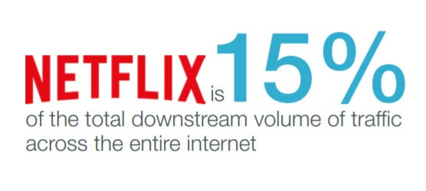
Benchmarks

Slide 34
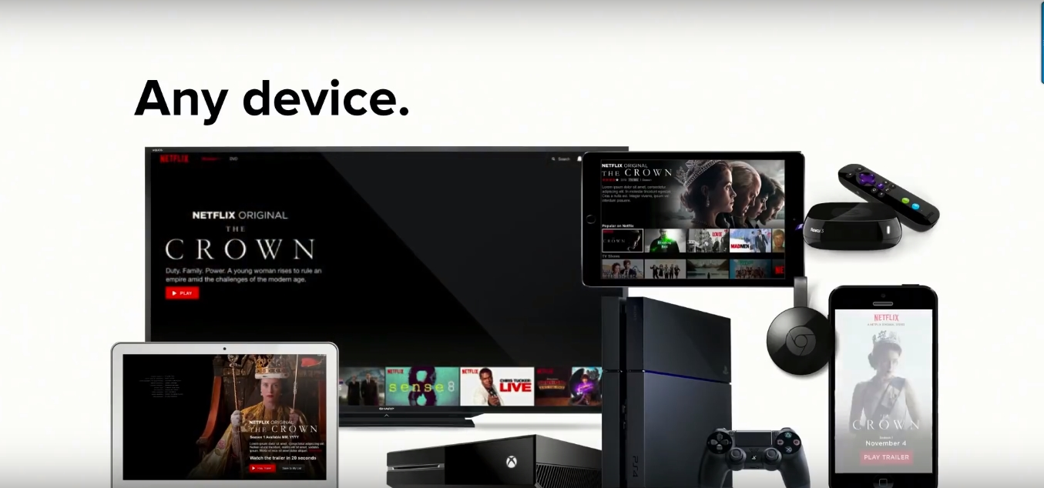
4300 different types of devices

Slide 35
Conclusion
Top 3 money making industries:
1) Sports
2) Gaming
3) Movie Making
Netflix VS YouTube in future

